Slide 1
DATA Analysis of Crime Rate in Chicago Using Hive
Presented By: Manasi Joshi, Lalit Chaudhari, Devang Sharma

Slide 2
Table of content
Crime Rate in Chicago
What have we used
SDLC
Hive Queries
Graphs and Final Results
Conclusion

Slide 3
Crimes
Crime include offenses such as
Criminal Damage : To property, to vehicle
Burglary, Theft, Robbery
Narcotics
Weapon Violation
Deceptive Practice
Battery
Assault,
Criminal Trespass

Slide 4
What is our project
Data analysis is done on Crime Rate in Chicago
Data analysis is done by using HDInsight Cluster (Microsoft Azure), HiveQL
Analyzed data will be visualized using Google Fusion table in the form of Graphs and Maps.

Slide 5
What have we used
Microsoft Azure
Azure Management Studio
Cloudberry Explorer
Google Fusion Table

Slide 6
System Development Life Cycle
Planning
Defined Scope
Analysis
Gathered data from Data.Gov
Design
Gathered required softwares such as Azure Management studio, Power View, Microsoft Azure
Testing
Requirement Gathering
Time Estimation
Created Tables
Implementation
Developed Queries
Analysis made on the created Tables using graph and Map

Slide 7
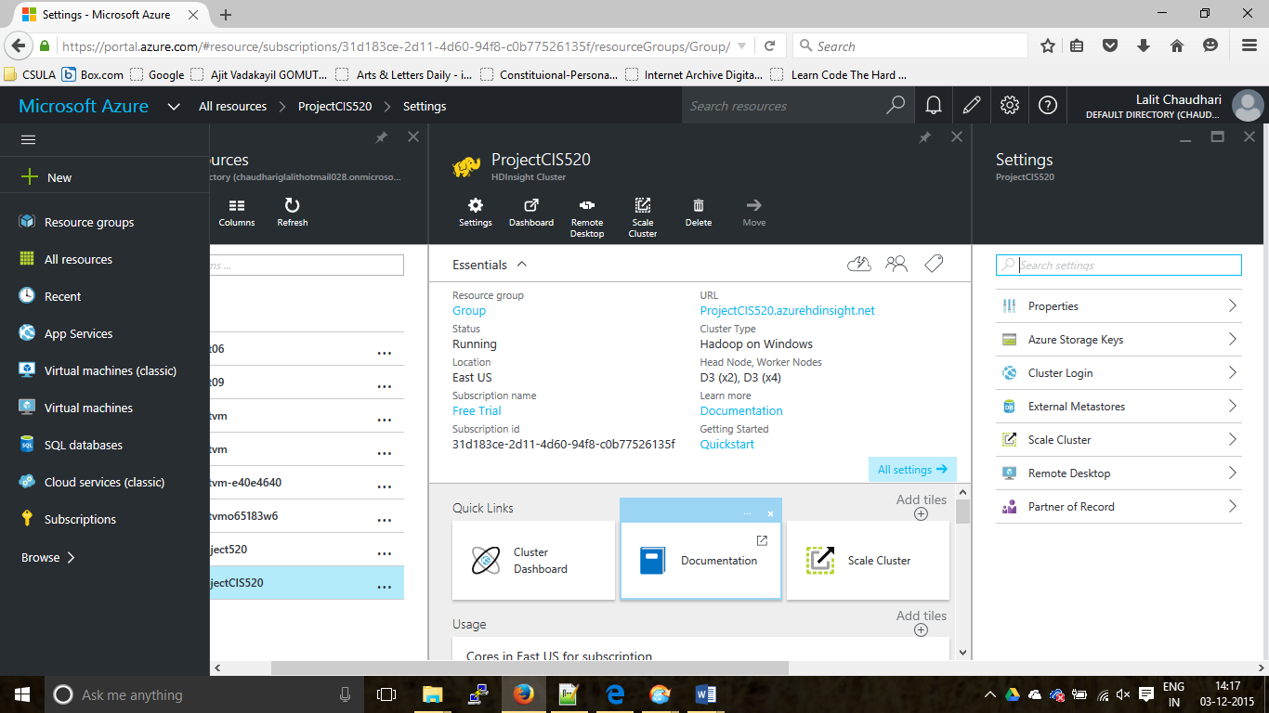
CREATING THE HDINSIGHT CLUSTER

Slide 8
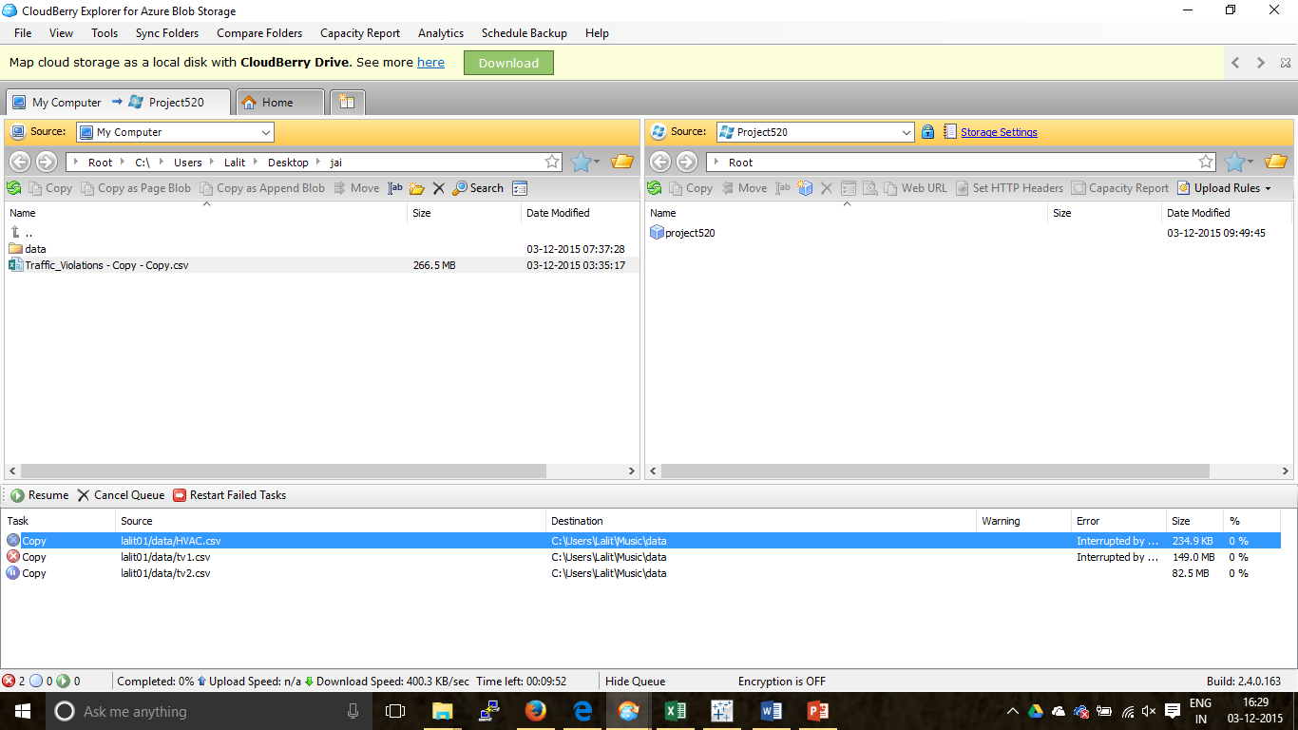
Data upload via cloudberry

Slide 9
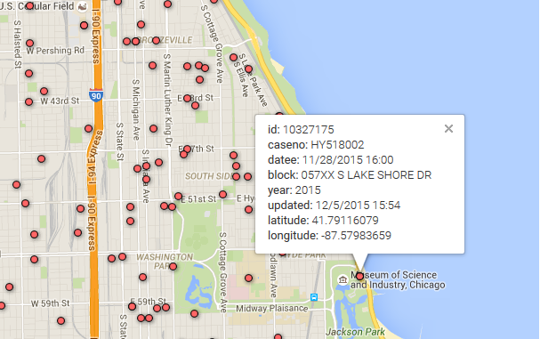
Query & Output
Query
Output
CREATE TABLE Chicago_Crimes(id string, caseno string, datee string, block string, iucr string, primarytype string, description string, locationdescription string, arrest string, domestic string, beat string, district string, ward string, communityarea string, fbicode string, XCoordinate string, YCoordinate string, year string, updatedon string, latitude string, longitude string)
ROW FORMAT DELIMITED FIELDS TERMINATED BY ','
STORED AS TEXTFILE LOCATION 'wasb://chicagocrimes@chicagocrimes.blob.core.windows.net/chicagocrimes/';

Slide 10
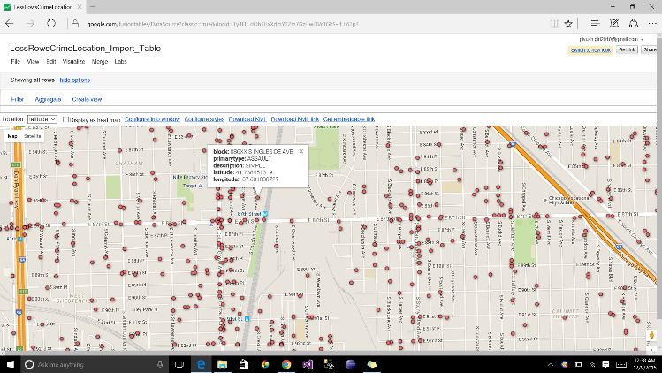
Query & Output
Query
Output
Create Table CrimeLocation(block string, primarytype string, description string, latitude string, longitude string);
INSERT OVERWRITE TABLE CrimeLocation
Select block, primarytype, description, latitude, longitude from Chicago_Crimes;

Slide 11
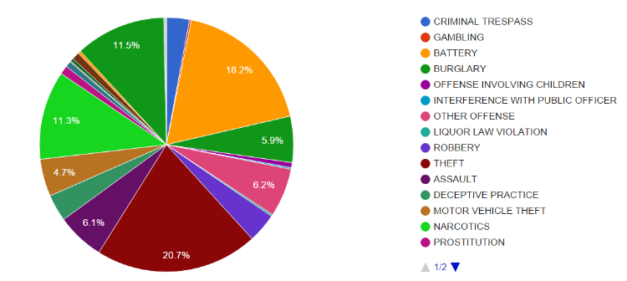
Query & Output
Query
Output
Create Table CrimeCount(primarytype string, crimecount string);
INSERT OVERWRITE TABLE CrimeCount
Select primarytype, Count (primarytype) from Chicago_Crimes Group by primarytype;

Slide 12
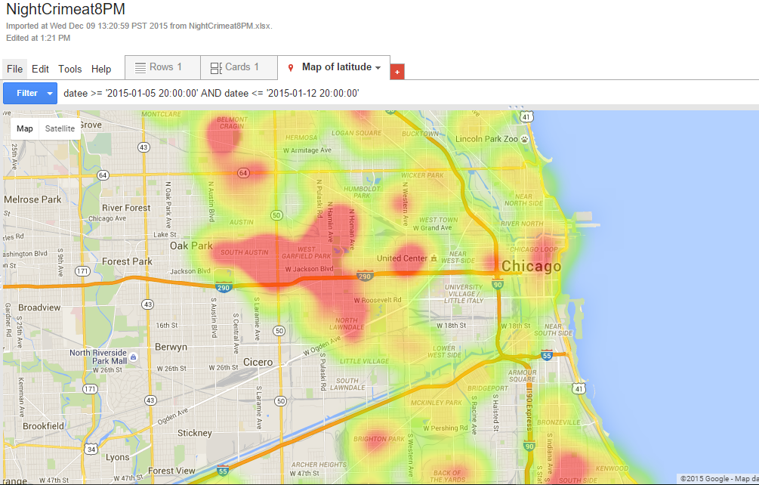
Query & Output
Query
Output 1
Drop Table If Exists NightCrimeat8PM;
Create Table NightCrimeat8PM(datee String, block string, description string, locationdescription string, latitude string, longitude string);
INSERT OVERWRITE TABLE NightCrimeat8PM
Select datee, block, description, locationdescription, latitude, longitude from Chicago_Crimes where datee LIKE '%2015 08:%:%PM';

Slide 13
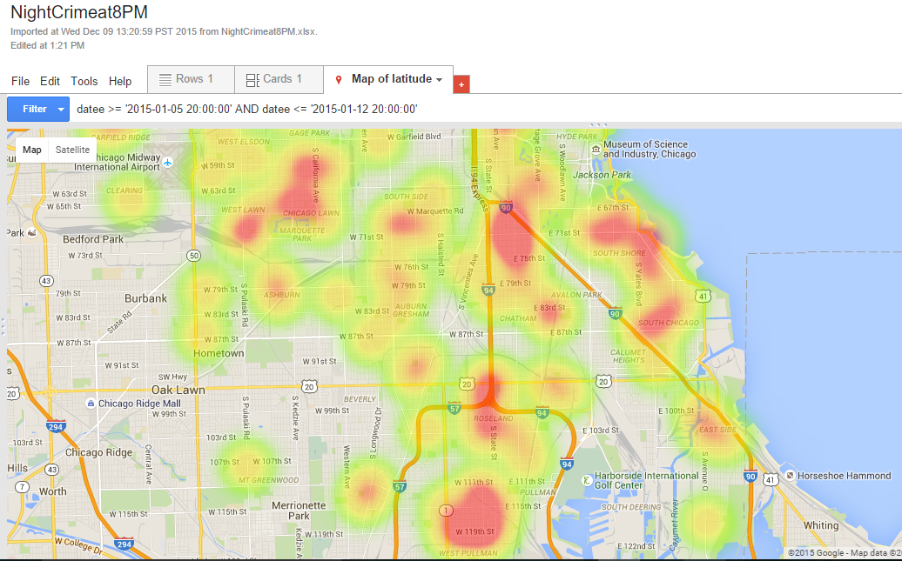
Query & Output
Query
Output 2
Drop Table If Exists NightCrimeat8PM;
Create Table NightCrimeat8PM(datee String, block string, description string, locationdescription string, latitude string, longitude string);
INSERT OVERWRITE TABLE NightCrimeat8PM
Select datee, block, description, locationdescription, latitude, longitude from Chicago_Crimes where datee LIKE '%2015 08:%:%PM';

Slide 14
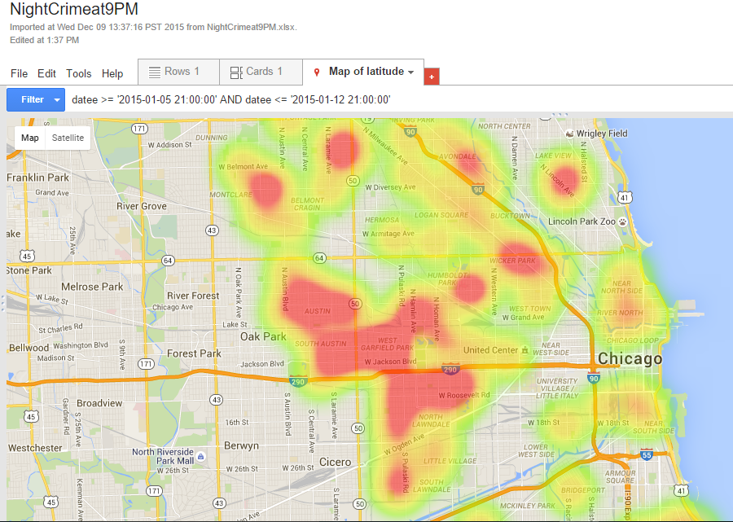
Query & Output
Query
Output 1
Drop Table If Exists NightCrimeat9PM;
Create Table NightCrimeat9PM(datee String, block string, description string, locationdescription string, latitude string, longitude string);
INSERT OVERWRITE TABLE NightCrimeat9PM
Select datee, block, description, locationdescription, latitude, longitude from Chicago_Crimes where datee LIKE '%2015 09:%:%PM';

Slide 15
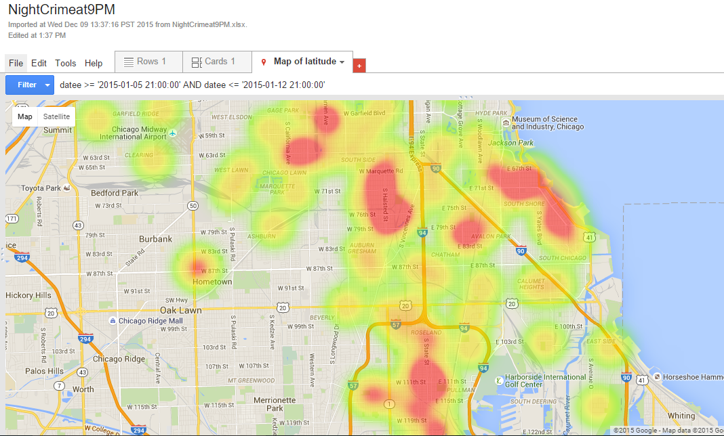
Query & Output
Query
Output 2
Drop Table If Exists NightCrimeat8PM;
Create Table NightCrimeat8PM(datee String, block string, description string, locationdescription string, latitude string, longitude string);
INSERT OVERWRITE TABLE NightCrimeat8PM
Select datee, block, description, locationdescription, latitude, longitude from Chicago_Crimes where datee LIKE '%2015 08:%:%PM';

Slide 16
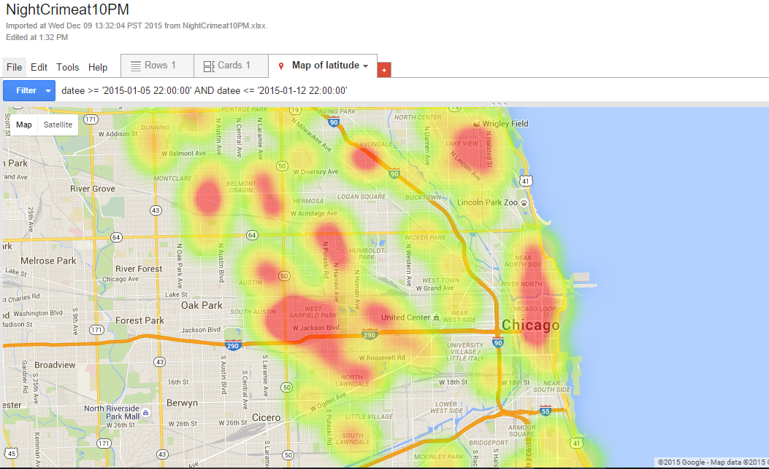
Query & Output
Query
Output 1
Drop Table If Exists NightCrimeat10PM;
Create Table NightCrimeat10PM(datee String, block string, description string, locationdescription string, latitude string, longitude string);
INSERT OVERWRITE TABLE NightCrimeat10PM
Select datee, block, description, locationdescription, latitude, longitude from Chicago_Crimes where datee LIKE '%2015 10:%:%PM';

Slide 17
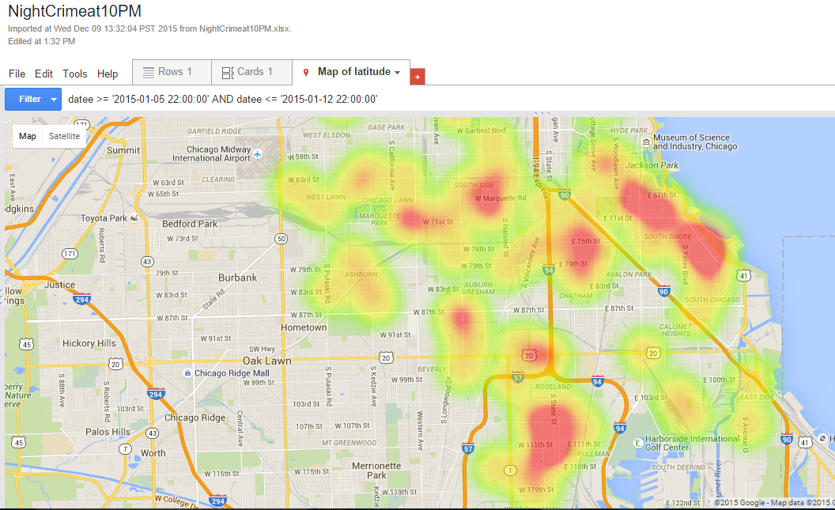
Query & Output
Query
Output 2
Drop Table If Exists NightCrimeat8PM;
Create Table NightCrimeat8PM(datee String, block string, description string, locationdescription string, latitude string, longitude string);
INSERT OVERWRITE TABLE NightCrimeat8PM
Select datee, block, description, locationdescription, latitude, longitude from Chicago_Crimes where datee LIKE '%2015 08:%:%PM';

Slide 18
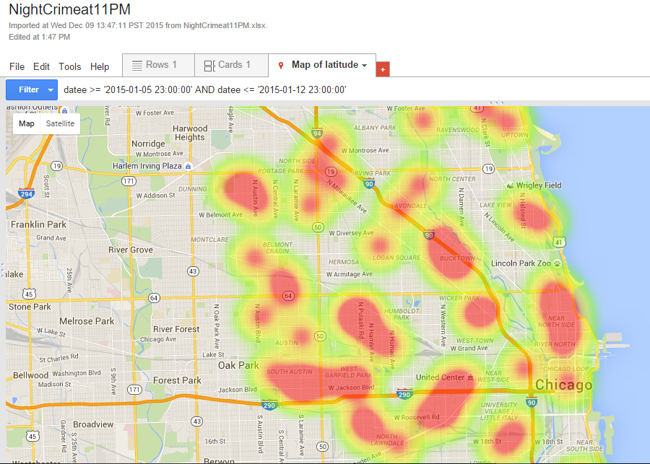
Query & Output
Query
Output 1
Drop Table If Exists NightCrimeat11PM;
Create Table NightCrimeat11PM(datee String, block string, description string, locationdescription string, latitude string, longitude string);
INSERT OVERWRITE TABLE NightCrimeat11PM
Select datee, block, description, locationdescription, latitude, longitude from Chicago_Crimes where datee LIKE '%2015 11:%:%PM';

Slide 19
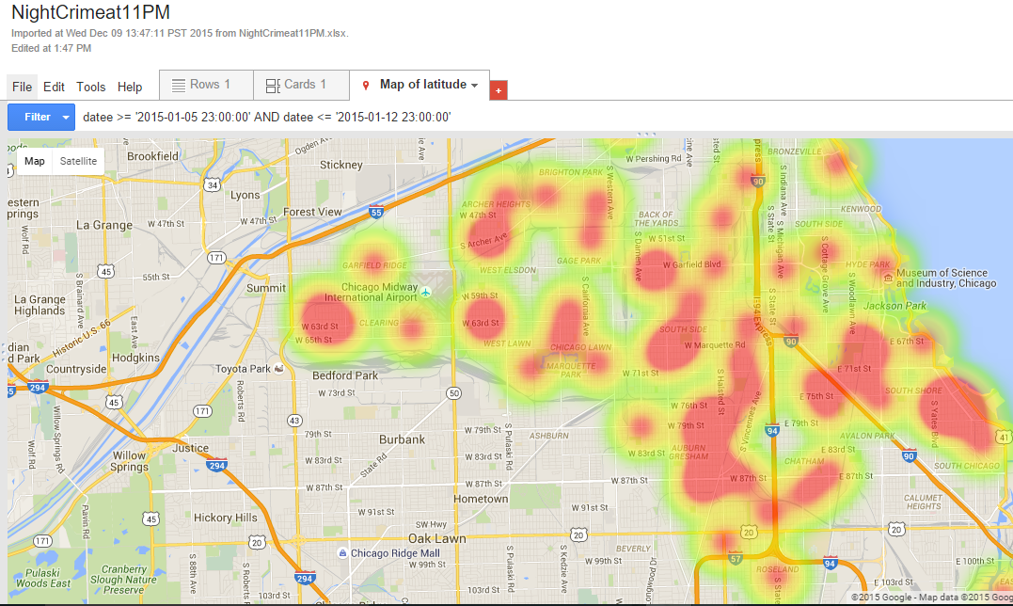
Query & Output
Query
Output 2
Drop Table If Exists NightCrimeat8PM;
Create Table NightCrimeat8PM(datee String, block string, description string, locationdescription string, latitude string, longitude string);
INSERT OVERWRITE TABLE NightCrimeat8PM
Select datee, block, description, locationdescription, latitude, longitude from Chicago_Crimes where datee LIKE '%2015 08:%:%PM';

Slide 20
conclusion
We have successfully analyzed the Crime Rate in Chicago City by using hive on HDInsight Cluster (Microsoft Azure)
Theft is the highest crime type observed.
From the heat map it is observed West Garfiled Park, South Austin are has the highest number of crimes during the time period 8 PM to 11 PM

Slide 21
Important Links
GitHub Link
https://github.com/lalit05/CIS_PROJECT_520/tree/master
Dataset Link
https://data.cityofchicago.org/Public-Safety/Crimes-2001-to-present/ijzp-q8t2
Data Period (2001 to present)
Dataset Size ( 1.3 GB)

Slide 22
THANK YOU
ANY QUERIES?

